Slide 1
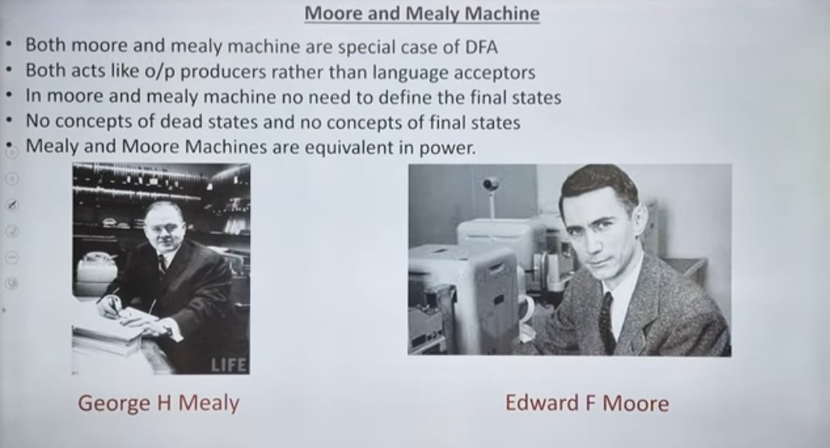

Slide 2
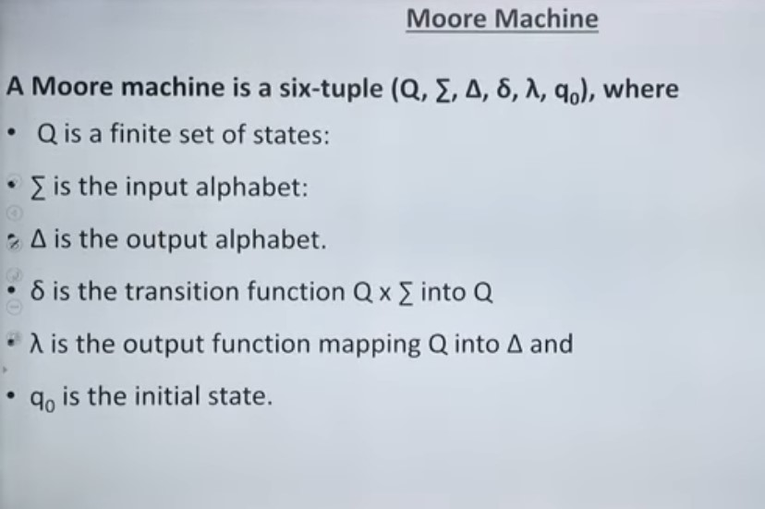

Slide 3
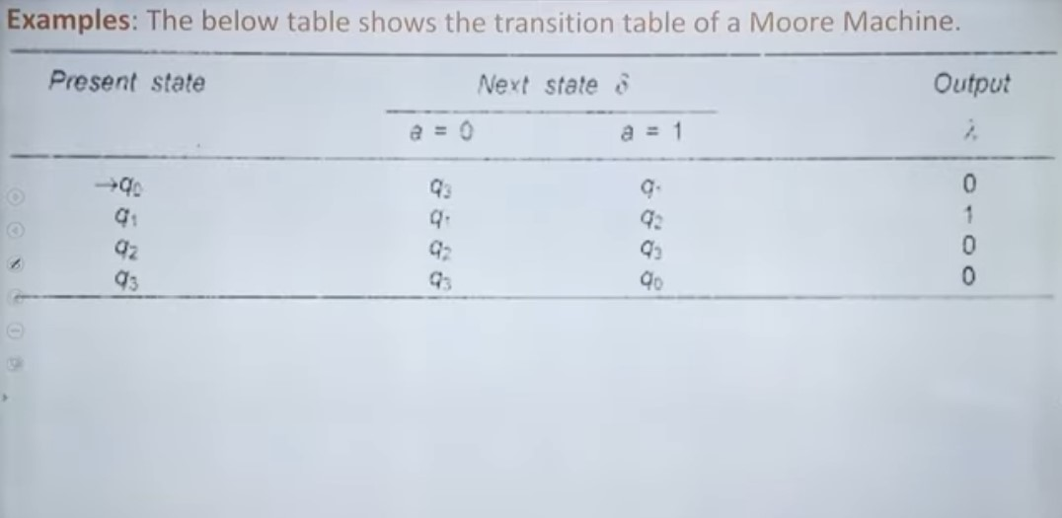

Slide 4
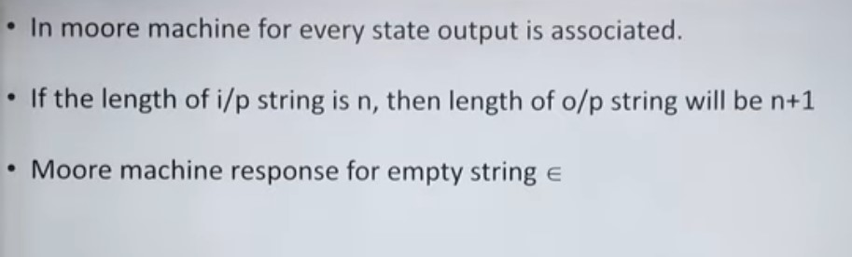

Slide 5
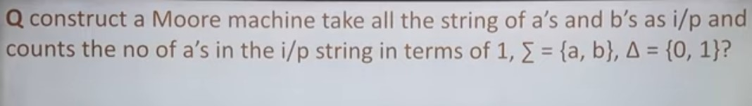

Slide 6
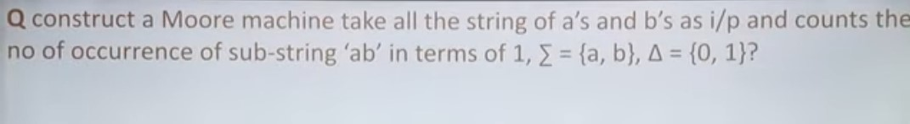

Slide 7
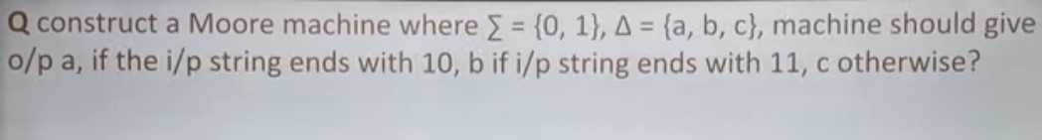

Slide 8
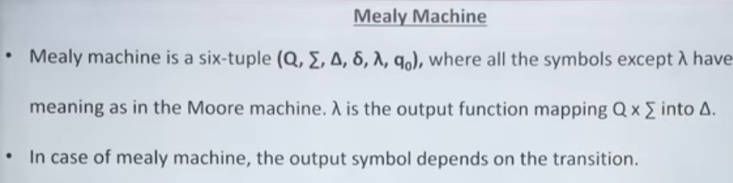

Slide 9
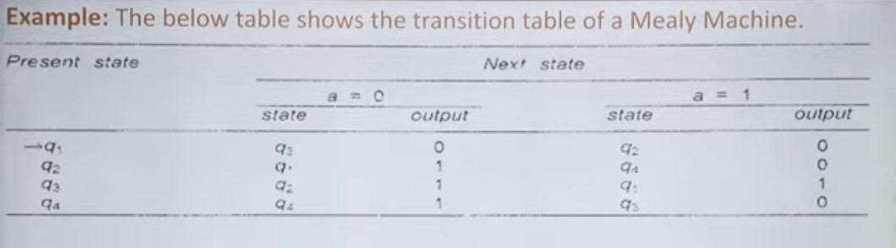

Slide 10
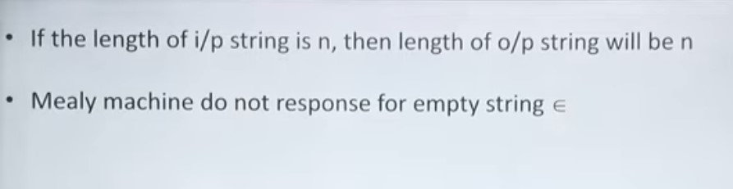

Slide 11
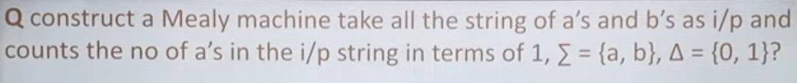

Slide 12
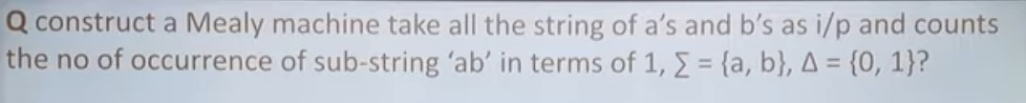

Slide 14
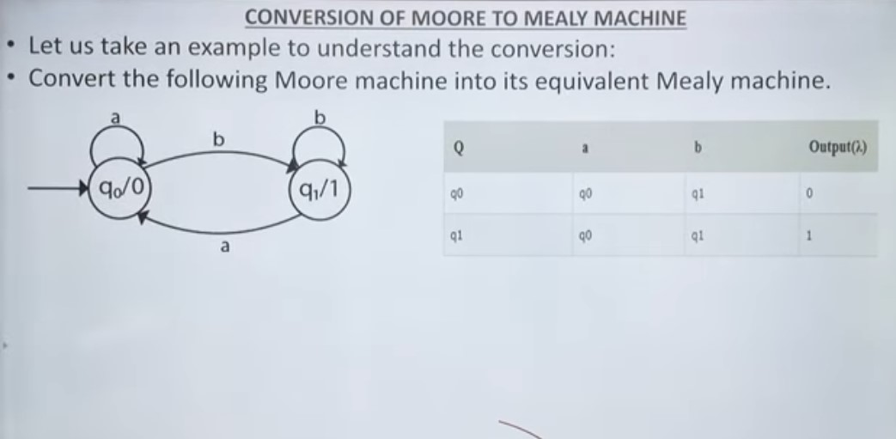

Slide 15
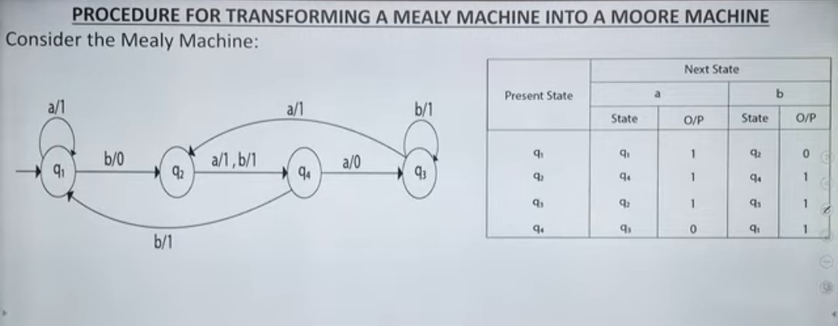

Slide 16
Regular Expressions:
A way of representing Regular Language.
A Language is said to be Regular Language if their exist a Regular Grammar.
A Language is said to be Regular Language if there exist a Finite Automata to accept it.
A Language is said to be Regular Language if there exist a Regular Expression to represent it. Regular Expression is Like a mathematics in which we use string in place of operands and some special different operators in place of +, -,*,/.
Expression of String & Operators RG
Like (1) * (Kleen Closure) [a*]
(2) + (Positive Closure) [a+] RL
(3) . (Concatination) [a.b]
(4) + (Union) [a+b] FA RE

Slide 17
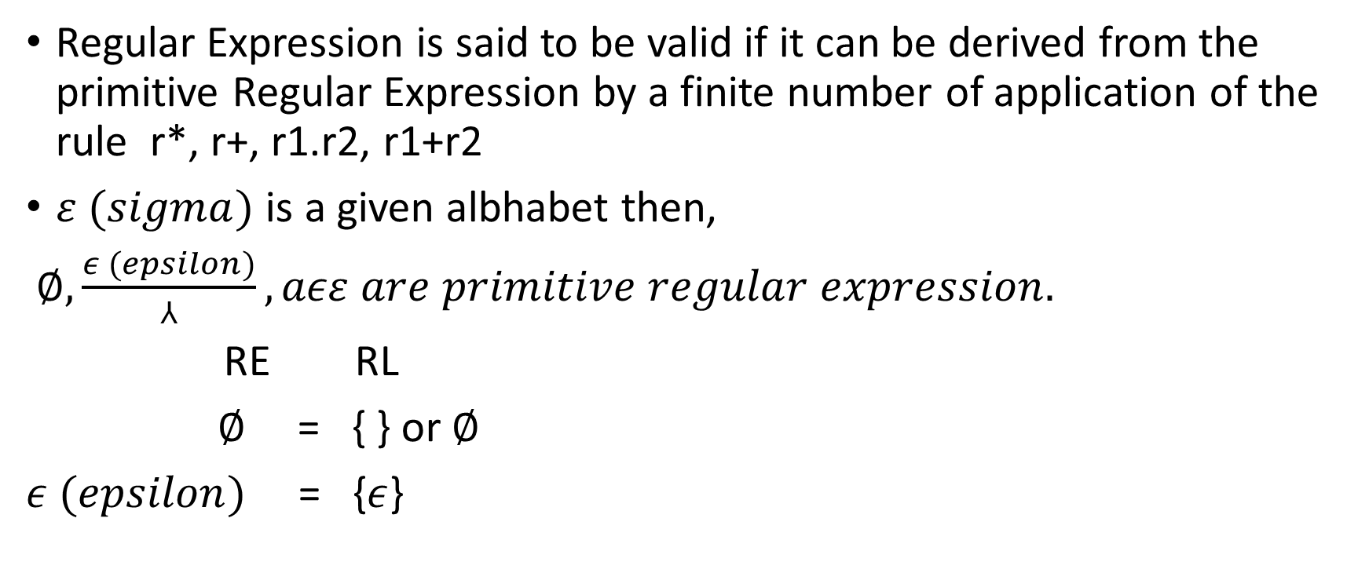
Regular Expressions:
Regular Expression is said to be valid if it can be derived from the primitive Regular Expression by a finite number of application of the rule r*, r+, r1.r2, r1+r2
$ε (sigma)$ is a given albhabet then,
$∅,\frac{ε (epsilon)}{⅄}, aεε are primitive regular expression.$
RE RL
$∅$ = { } or $∅$
$ε (epsilon)$ = {$ε$}

Slide 18
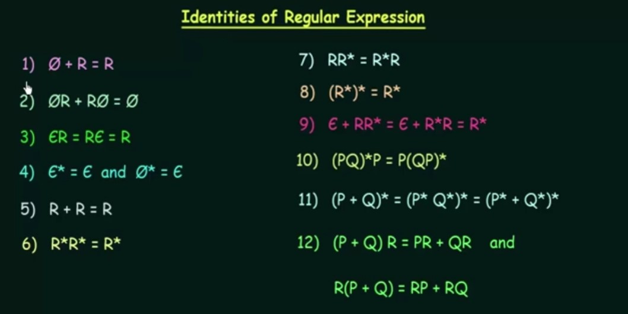

Slide 19
